Slide 1
RENT-A-MOVIE
Project Manager: Christopher
Information Architect: Sukhbir
Database Developer: Saad
UX Developer: Thanushan
UI Designer: Corey

Slide 2
PROJECT SUMMARY
Online movie rental
Subscription based
Multiple subscription tiers.
Straightforward UX
Minimalistic User Interface

Slide 3
Site Map & Requirements Documentation
Fluent navigation
Numerous options
Option for Parent Control
User Settings
Sorting Method

Slide 4
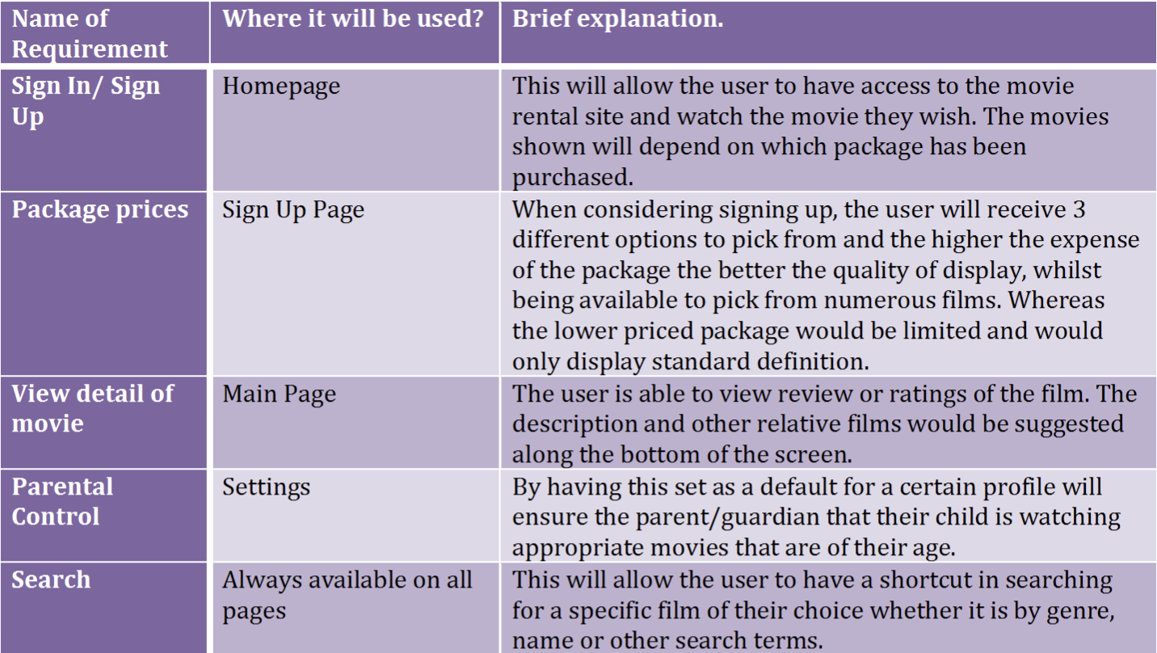
Requirement Specification

Slide 5
Objectives
Static website – allows easier navigation around the site, making it accessible to people of various ages. The navigation system will be straightforward in order to find the film that the user wants to watch.
Registration – whilst being logged in users will have access to their own profiles with their elements and preferred films. This will also allow the user to set suitable setting on the website accordingly, for example, parental controls maybe adjusted so that children can only view films of their age.
User experience – to ensure that the customer is allows happy with their movie or the website we will be adding in a reviews page. Allowing other viewers to see whether the film is of their choice.
Frequent Update – in order for the website to stay active and to increase the availability of the movies for users, frequent updates will be made to ensure that any errors are to be fixed and the user is satisfied with the overall website. The design would not be a priority during the update and we will strive for consistency.
Reducing costs – this will be a priority as many users seem to complain about the costs of having monthly subscriptions to these type of website and thus we will ensure that the affordability bracket is not out of reach for our target market.

Slide 6
E/R Diagram

Slide 7
Database

Slide 8
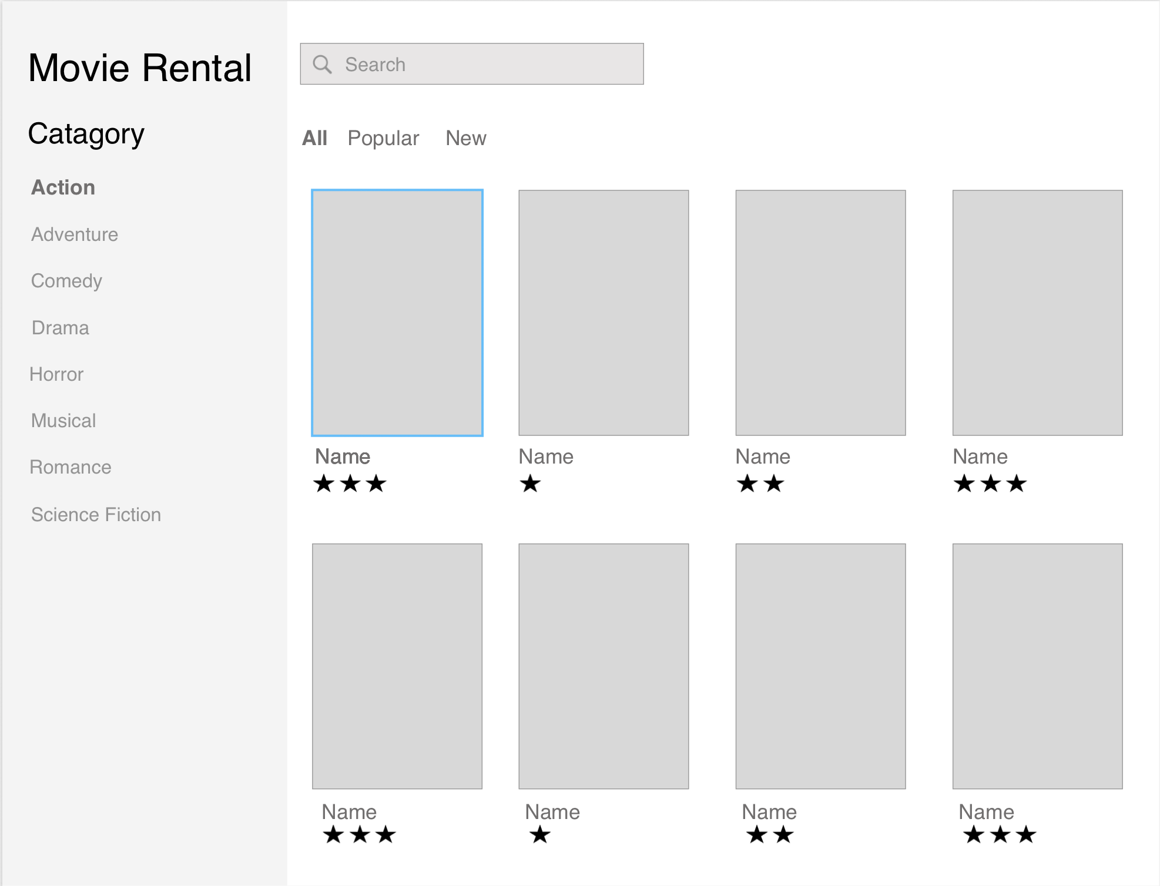
Wireframe
Overview of plan on the homepage of website
Allows further development

Slide 9
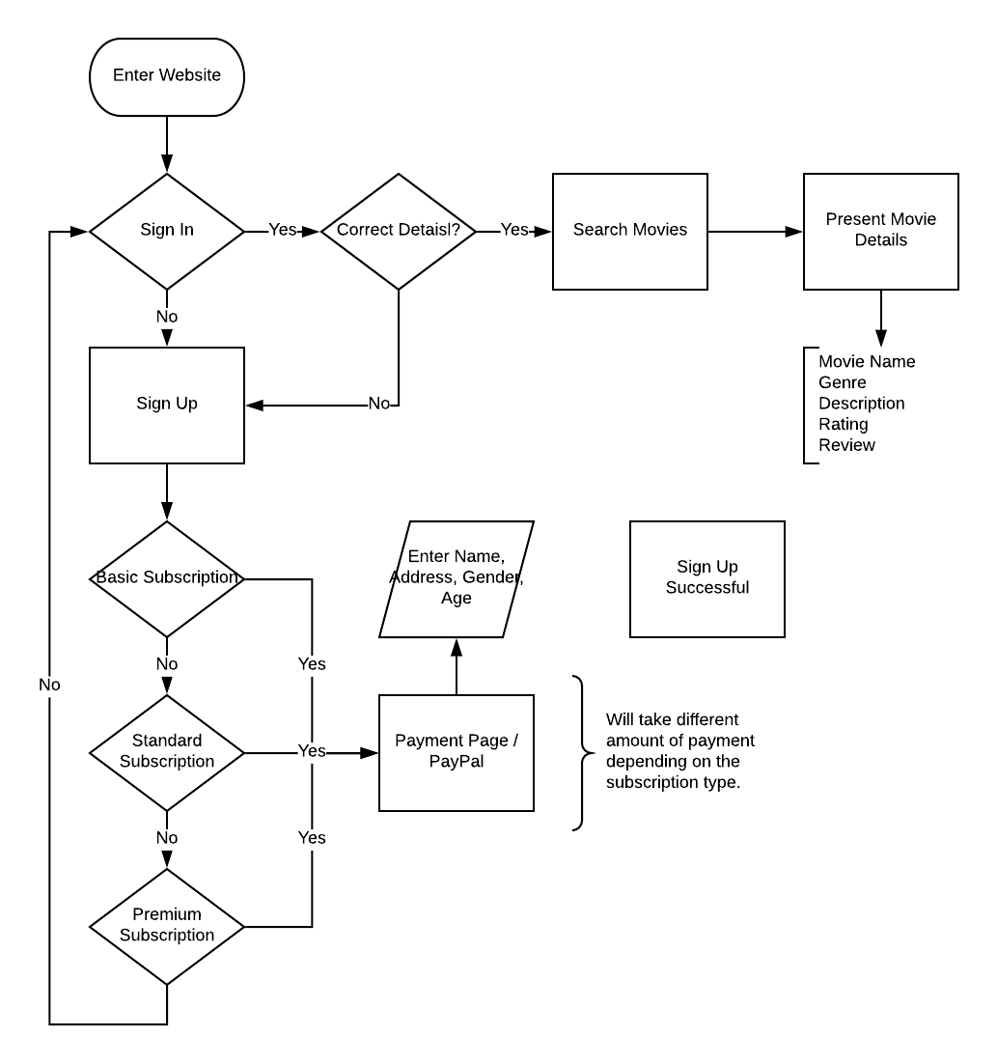
Flow Chart
Basic navigation through the website for all users.

Slide 10
Mock-Ups - Sign Up

Slide 11
Mock-Ups - Home

Slide 12
Mock-Ups – Movie Detail

Slide 13
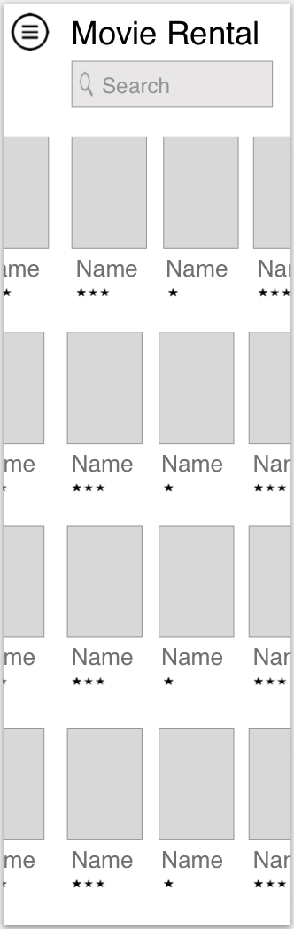
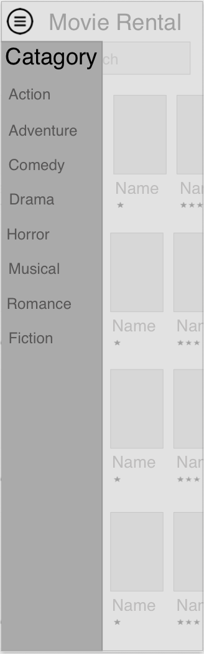
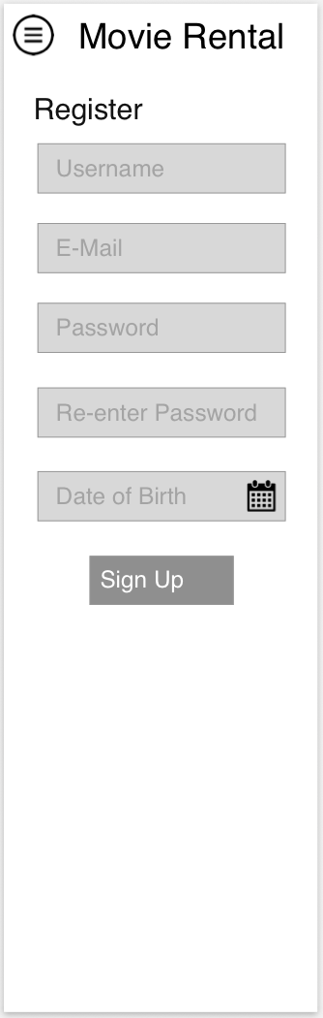
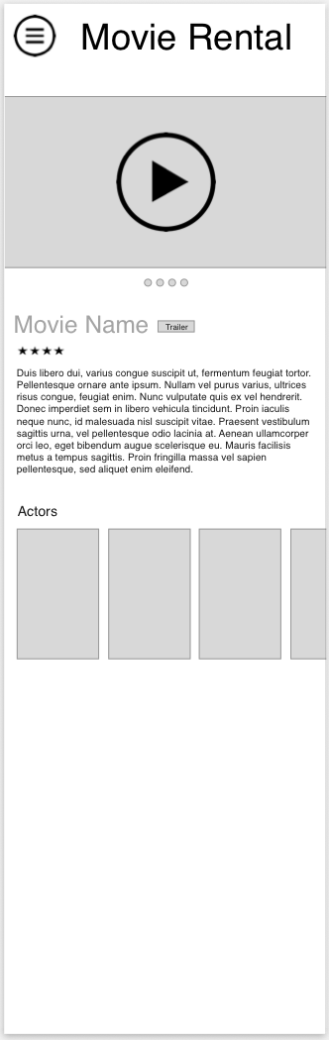
Further Development – Mobile UI

Slide 14
Final Thoughts & Questions

